Slide 1

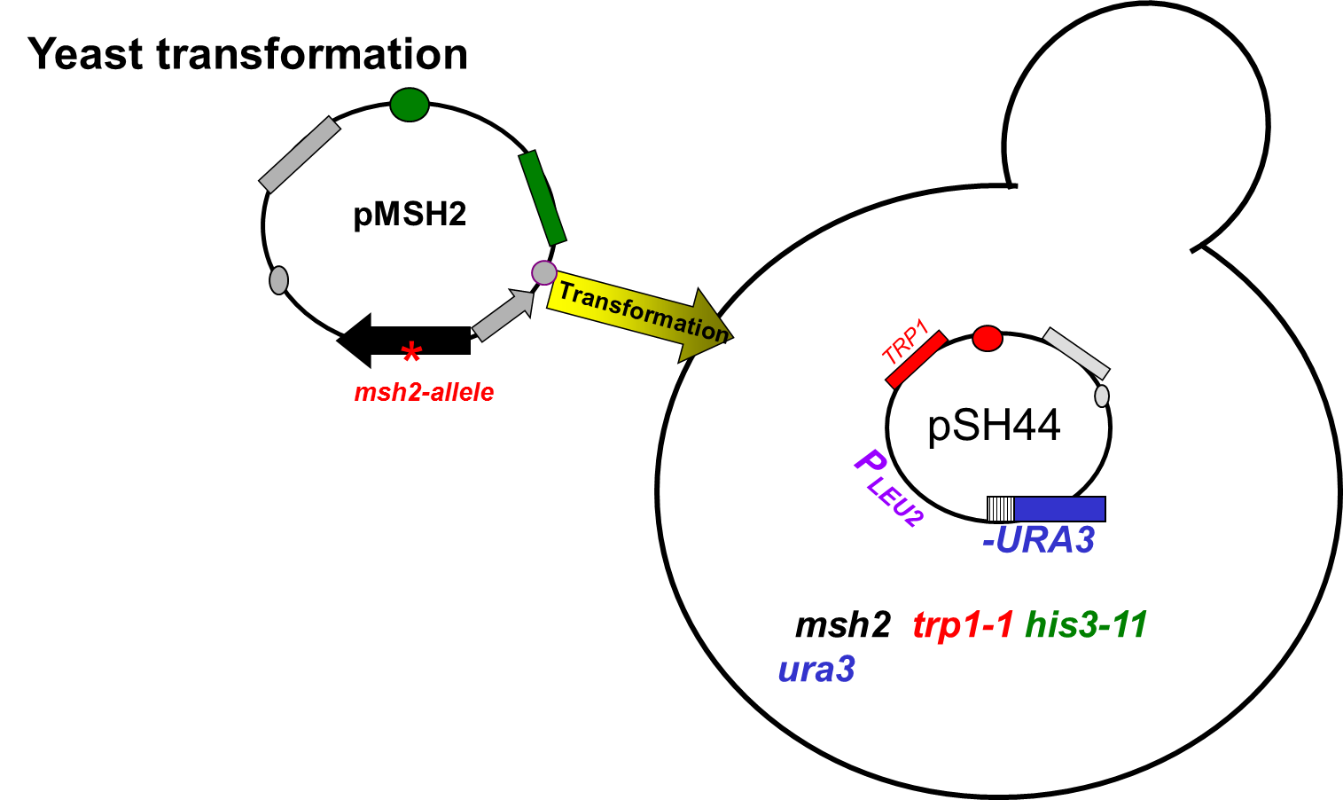
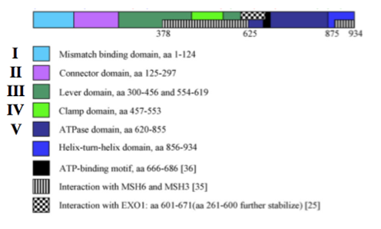

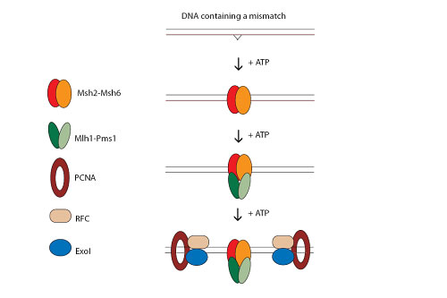
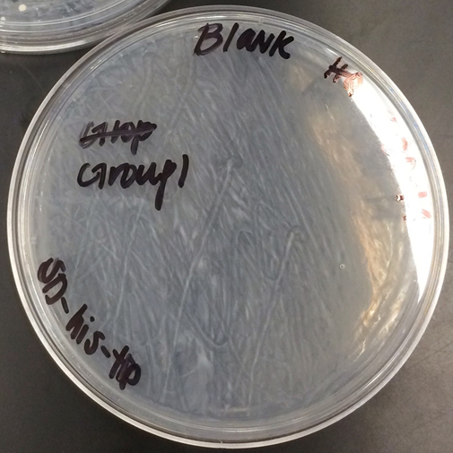
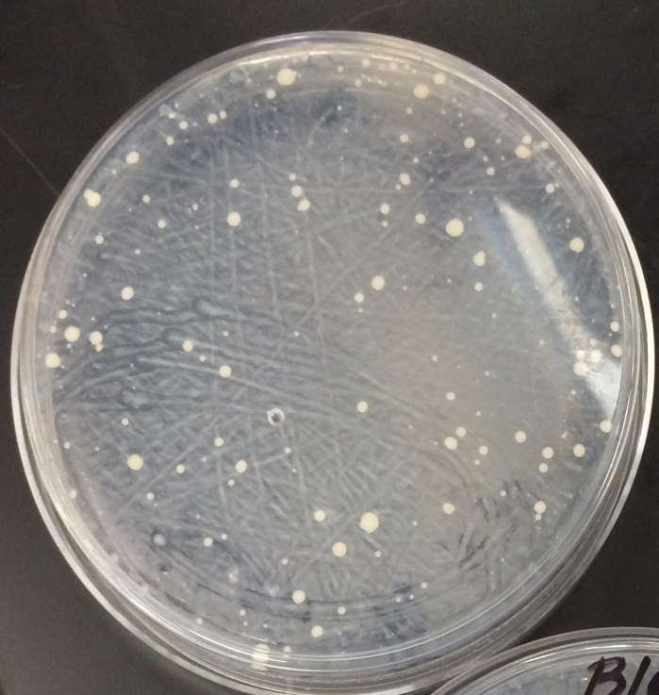
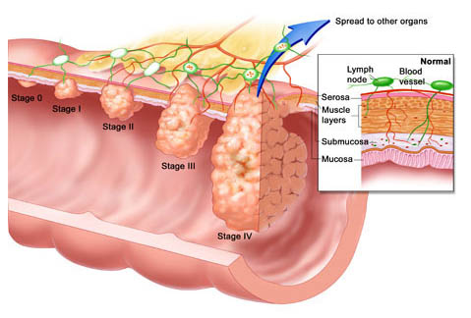
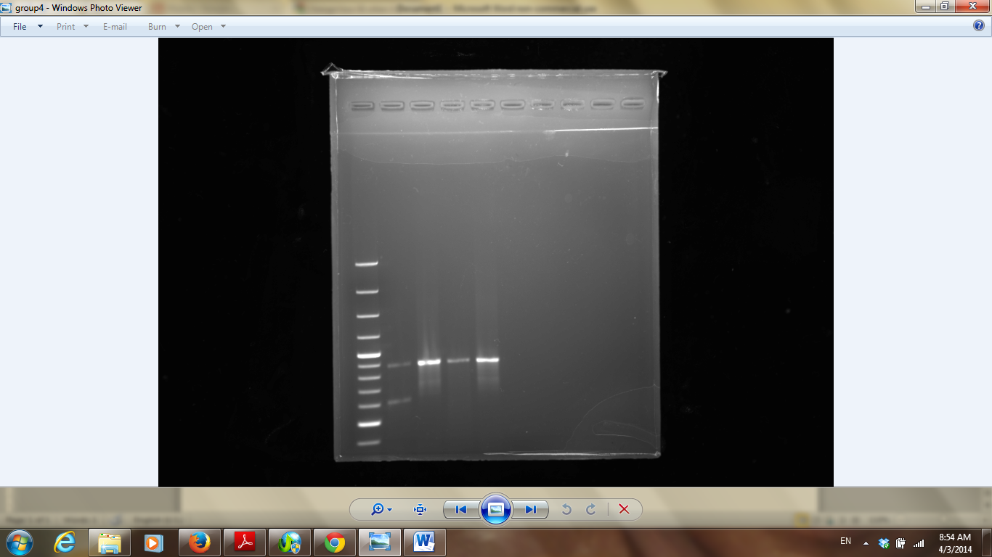
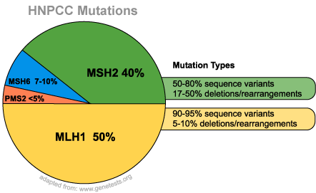
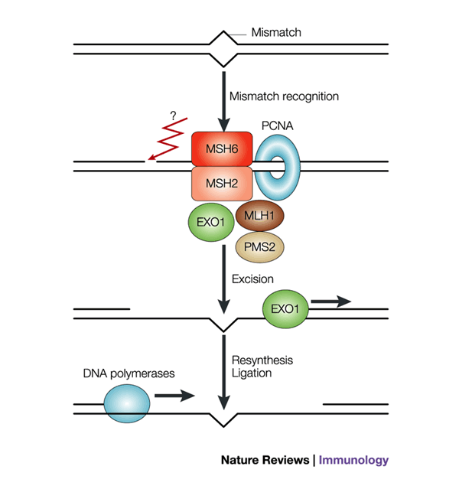
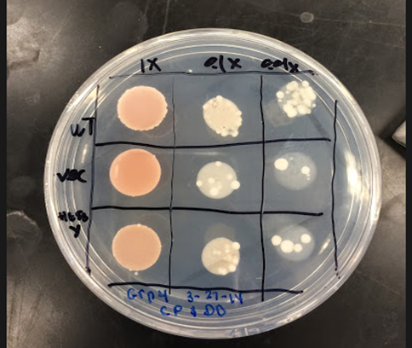
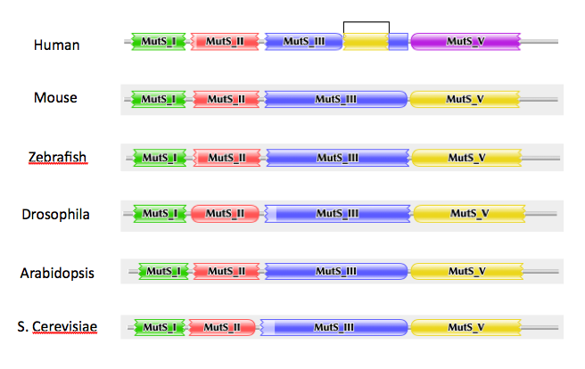



Functional Studies of the Human MSH2 Missense Mutations in Yeast Provide
Insight to Hereditary Nonpolyposis Colon Cancer
Dominique Djedjro, Chezlyn Patton
^{Advisor: Dr. Hong Qin}
Department of Biology, Spelman College, Atlanta, GA 30314
Abstract
Materials and Methods
Conclusions
One of every twenty Americans will be affected with Colorectal Cancer (CRC) with Hereditary Non-Polyposis Colorectal Cancer being the most common (HNPCC). This type of cancer is a hereditary gene caused by a missense mutation on the 2nd chromosome of the human DNA. To conduct our research, we used Saccharomyces cerevisiae cells, specifically the msh2 strain. These yeast cells serve as a model for understanding human MSH2 mutations, which is a tumor suppressor. The purpose is to manipulate the yeast MSH2 gene to determine which missense mutation is likely to be benign or pathogenic. We examined the defects at a molecular level to determine what MSH2 variants are dysfunctional by using a DNA mismatch pair and the reporter plasmid, pSH44, fused with URA3. The mismatch repair efﬁciencies were determined qualitatively using the 5-ﬂuororotic acid monohydrate (FOA) dinucleotide instability plate assays resulting in the formation of 5-FU. With the occurrence of 5-FU, the yeast cells should die; however, the ability of yeast cells to survive in the presence of 5-FOA reveals a dysfunction in mismatch repair. Defining the consequences of missense mutation within the MSH2 gene could result in the development of biomarkers for early detection of HNPCC.
H658Y
Fig.5 Human MSH2 requires ATP in order to work
Future directions would be necessary to find out if could be the effect of a lack of ATP in the mismatch repair. Also, what could affect the complex MSH2-MSH6 in the mismatch repair and what would be the consequences.
Results
PCR and Restriction Enzyme Analysis
Transformation of MSH2
5’ TCCCGTTCATCCAGT 3’ WT, Histidine
3’ AGGGCAAGTCGGTCA 5’
SD-HIS-TRP
Introduction
5’ TCCCGTTTACCCAGT 3’ Mutant, Tyrosine
3’ AGGGCAAATGGGTCA 5’
A
B
BmrI
Hereditary Nonpolyposis Colorectal Cancer
Uncut, mutant
Cut, WT
Uncut, WT
Cut, Mutant
Size Ladder
Fig2. A. The blank lacks Histidine and Triptophane that are necessary for the yeast growth. B. The medium with the mutant msh2 has been transformed with the reporter plasmid pSH44. Histidine and Triptophane previously removed from the yeast are now expressed which allows cell growth.
Fig6. Mismatch repair requires energy, ATP, that cannot be used by the mutant, H658Y.
Fig1. PCR fragments generated after confirmation of the mutagenized MSH2 by digestion with RE BmrI. BmRI only cuts the mutagenized plasmid which helps distinguishing between mutant allele and the wild type.
Implication in Human MSH2 Mutations
MSH2 is a major cause
of HNPCC
Assessment of mutation in URA3 using FOA plates
Mutations in
human MSH2
Conserved MMR between Human and Yeast
Interventions
(Overexpression)
?
Mutations in yeastMSH2
Fig3. Because the cells survived and their frequency is approximately the same throughout the grid, There is a mismatch repair defect. MSH2 is then not functional. But, there may be experimental error. The vector and wild type lanes may have been switched. The vector should contain more cells due to the absence of MSH2 which provides MMR-
Functional Studies
References
A
B
Gammie, A. E., and N. Erdeniz. “Characterization of Pathogenic Human MSH2 Missense Mutations Using Yeast as a Model System: A Laboratory course in Molecular Biology.” Cell Biology Education 3.1 (2004): 31-48. Print
Gammie, A. E., and N. Erdeniz. “Functional Characterization of Pathogenic Human MSH2 Missense Mutations in Saccharomyces Cerevisiae.” Genetics 177.2 (2007): 707-21. Print.
Conserved MSH2 between Human and Yeast
chromosome: msh2Δ
trp1-1
his3-11,15
chromosome: msh2Δ
trp1-1
his3-11,15
TRP1/ARS
pSH44
TRP1/ARS
HIS3
P_{LEU2}
CEN11
pSH44
mutagenized
(GT)_{16.5}-URA3
HIS3
P_{LEU2}
CEN11
*
X
mutagenized
(GT)_{16.5}-URA3
Experimental Objective
Msh2-H658Y
X
X
MSH2
mismatch repair
Acknowledgements
The objective of this experiment is to determine if the study
of human MSH2 mutation in yeast provides insight to HNPCC
5FOA
FU
5FOA
FU
Dr. Hong Qin, Dr. Stephen Kioko, and all of our classmates for being of great help and support throughout the semester.
Fig4. A. msh2 does not allow the cells to fully absorb FU which allow them to grow. B.MSH2 allows most cells to absorb FU which cause them to die.

